Slide 1

A
Project Presentation
on
“Audacity Audio Analysis Tool”
Ms.Rutuja Jalindar Athare(4104)
Ms.Urmila Uttam Barkade(4108)
Ms.Sanjivani Pandurang Dhande(4128)
Ms.Apeksha Bajirao Dhomse(4130)
Under The Guidance of Dr. M. A. Wakchaure

Slide 2
Introduction
Digital forensic investigations often involve the analysis of various types of digital evidence, including audio files.
Tools should provide the necessary features and capabilities to effectively examine audio files for evidence collection, authentication, and analysis.
Audacity is an open-source, cross-platform audio editing software that is widely used for recording, editing, and manipulating digital audio.
It is a powerful and user-friendly tool that allows individuals to work with audio files in a variety of formats.

Slide 3
Feature Of Audacity
Recording: You can record live audio from a microphone or other input device, or you can import audio files from other sources.
Editing: You can edit your audio recordings by cutting, copying, pasting, and deleting parts of the audio. You can also apply effects to your audio, such as equalization, noise reduction, and reverb
Spectrogram view: The spectrogram view allows you to visualize the frequency content of your audio. This can be helpful for identifying and removing noise.
Label tracks: Label tracks allow you to add text annotations to your audio. This can be helpful for organizing and keeping track of your audio files.

Slide 4

Short Key
Export Audio: Ctrl+Shift+E
Trim Audio: Ctrl+T
Add Label At Selection: Ctrl+B
Cut : Ctrl+X
Delete: Ctrl+K
Preferences: Ctrl+P

Slide 5
Upload Audio In Audacity
Open Audacity: Launch the Audacity application on your computer.
Create a New Project : If you're starting a new project, go to "File" > "New" to create a new project. If you have an existing project, you can skip this step.
Import Audio File:a. Go to "File" > "Import" > "Audio..."b. Navigate to the location of the audio file you want to upload, select it, and click "Open.“
Your audio file will now appear in the Audacity workspace as a new track, and you can edit and manipulate it as needed.
Save: You can use the "File" > "Save Project" option to save your Audacity project file, or "File" > "Export" to save the edited audio as a separate audio file when you're done.

Slide 6
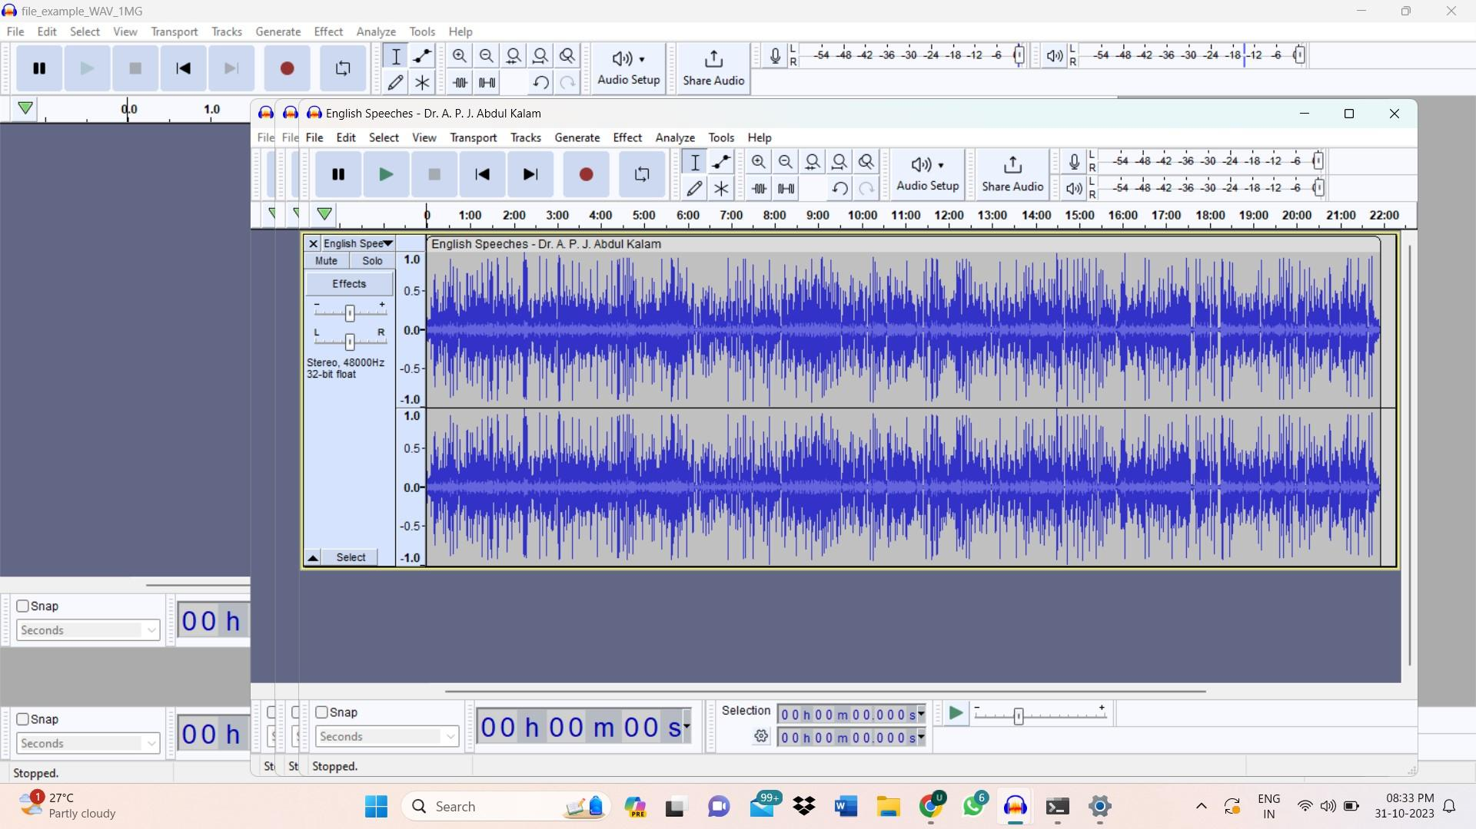
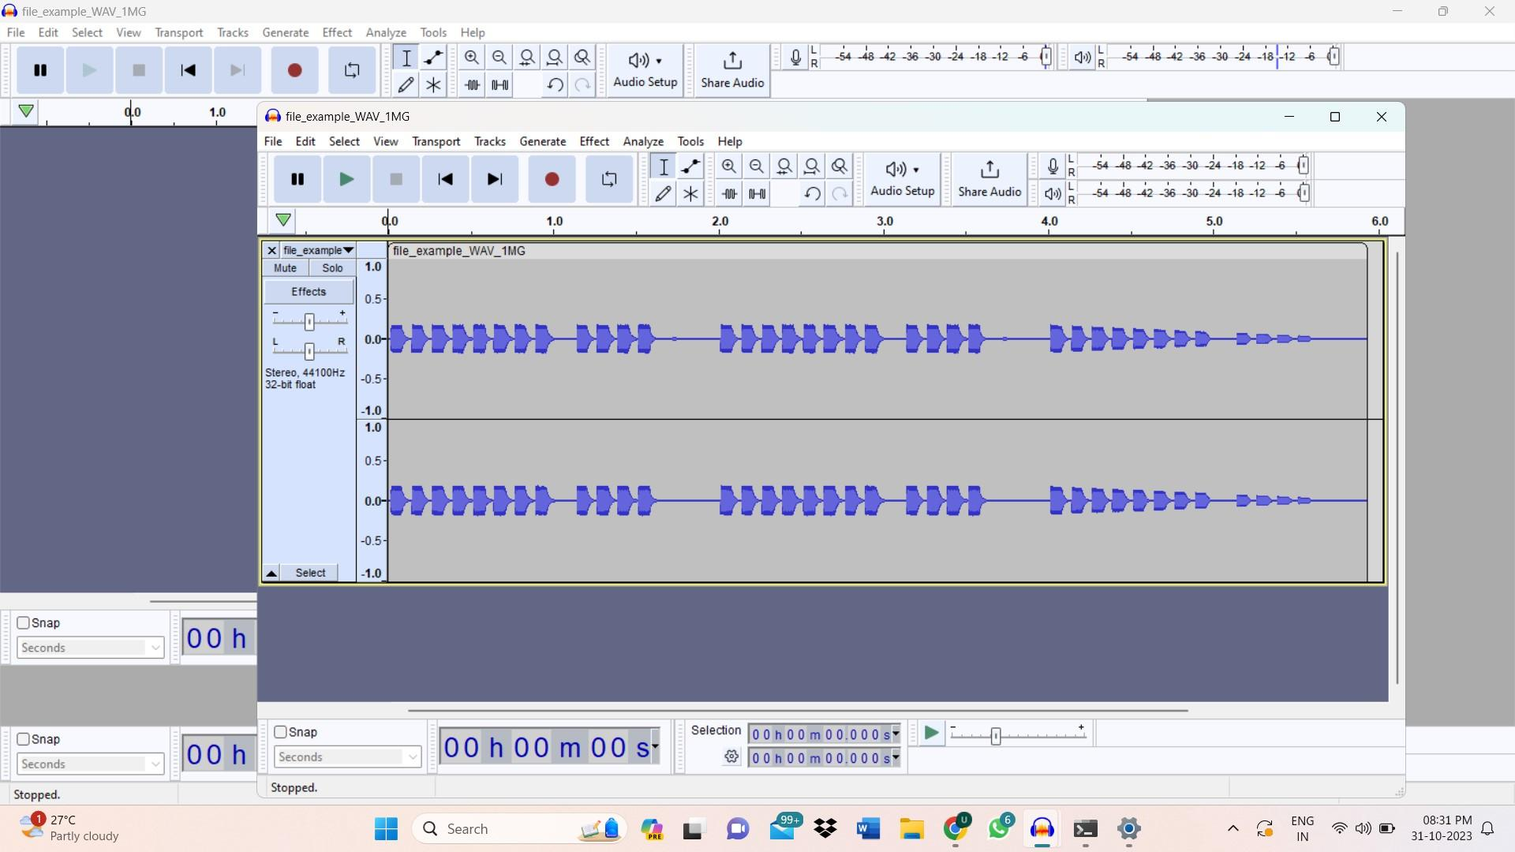
Output of Audacity
Speech Audio
Audio Tune

Slide 7
Thank You !!

